Slide 1

E-Commerce Customer Segmentation: Unlocking Value Through Machine Learning
Data Analyst Trainee Program - Final Capstone Project
Lalatendu Nilakantha Sahoo

Slide 2
Executive Summary: Applied RFM (Recency, Frequency, Monetary) modeling and K-Means clustering to 37,493 transaction records to identify four distinct customer personas, providing a data-driven blueprint for targeted marketing and retention.

Slide 3
Context & Methodology
Business Problem: A one-size-fits-all marketing approach wastes resources. The objective is to segment the customer base using historical purchasing behavior to drive personalized engagement and maximize ROI.
Data Processing: Ingested 62,551 raw transaction rows from the Online Retail Dataset. Cleaned data by removing null customer IDs, canceled orders, and negative values to isolate valid revenue. Final working dataset: 37,493 transaction records.
Algorithmic Approach: Engineered RFM metrics (Recency, Frequency, Monetary Value) per customer. Scaled features using Standard Scaler to normalize variance. Applied K-Means Clustering (n=4) using Python and Scikit-Learn.

Slide 4
The 4 Customer Personas (Key Findings)
Cluster 0: The VIPs (15 Customers)
Metrics: Avg Spend: $12,700 |Avg Frequency: 12.7 orders
Profile: High-value, highly loyal brand advocates who generate disproportionate revenue.
Cluster 1: At-Risk / Casual (667 Customers)
Metrics: Avg Spend: $446 | Avg Recency: 39.3 days
Profile: The largest segment. Characterized by low spend and high churn risk (haven't purchased recently).
Cluster 2: The Wholesale 'Whale' (1 Customer)
Metrics: Spend: $77,183 | Frequency: 1 order
Profile: A massive outlier representing B2B or wholesale purchasing behavior.
Cluster 3: Recent Actives (428 Customers)
Metrics: Avg Spend: $888 | Avg Recency: 8.2 days
Profile: Healthy, engaged customers who bought recently and represent the core growth demographic.

Slide 5
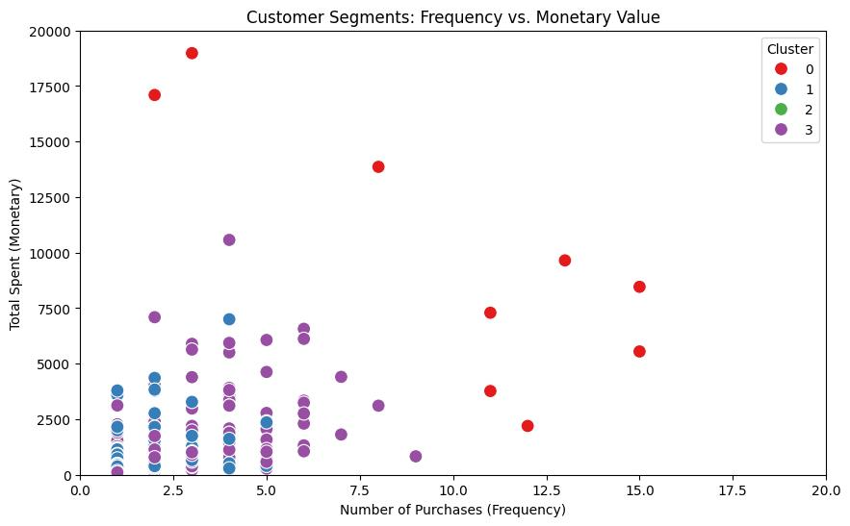
Visualizing the Segments
Key Chart Takeaways :The visualization clearly maps the behavioral boundaries of our consumer base, highlighting the massive spending gap between the VIP group (Red) and the standard customer base (Blue/Purple).The $77k outlier (Green) required axis capping to properly visualize the density of the core consumer segments.

Slide 6
Actionable Business Recommendations
For VIPs (Cluster 0): Implement a white-glove retention strategy. Offer early access to new product drops, exclusive loyalty tiers, and assign dedicated account managers.
For Recent Actives (Cluster 3): Launch immediate cross-sell email campaigns. Capitalize on their recent engagement by offering bundle deals to push their lifetime value into the VIP tier.
For At-Risk (Cluster 1): Deploy automated win-back campaigns. Send "We Miss You" emails containing time-sensitive, high-value discount codes to re-engage them before they churn completely.
For Whales (Cluster 2): Route these buyers directly to a specialized B2B sales team to negotiate wholesale contracts and secure recurring bulk orders.

